Slide 1
Important Dates
Assignment #1: Intro to R/Python, GitHub, and developing a Portfolio – Opens 9/13
Research Proposal Instructions will be handed out. (9/13)
Assignment #2: Applying Analysis Techniques and Statistical Inference to Data: Opens 10/4
Assignment #1: Due 10/4
Students Research Proposals Due: (10/4)

Slide 2
Agenda
Linear Algebra Review
How NASA Finds Critical Data Through a Knowledge Graphs
GWU Elliott School, Room B-12 1957 E St. NW Washington, DC
6:30pm – 8pm
Do HW 0 at home. Will review on next week.

Slide 3
Matrix: Rectangular array of numbers:
Dimension of matrix: number of rows x number of columns

Slide 4
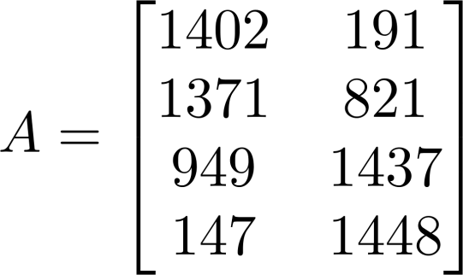
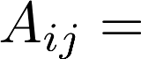


Matrix Elements (entries of matrix)
“ , entry” in the
row,
column.

Slide 5
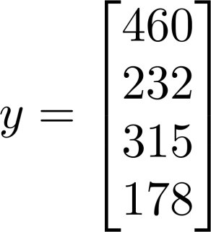
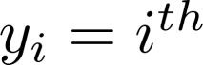
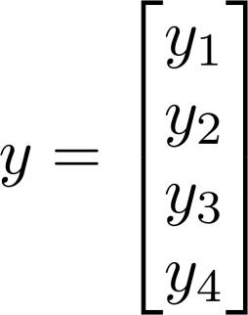
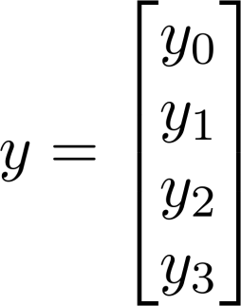
Vector: An n x 1 matrix.
1-indexed vs 0-indexed:
element

Slide 6
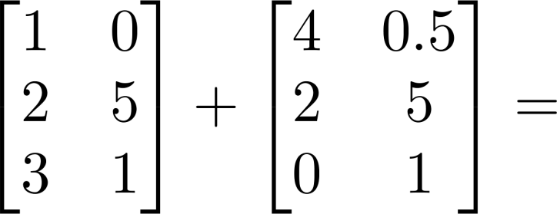
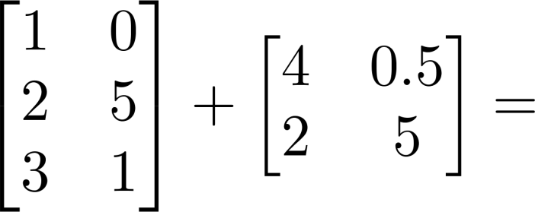
Matrix Addition

Slide 7
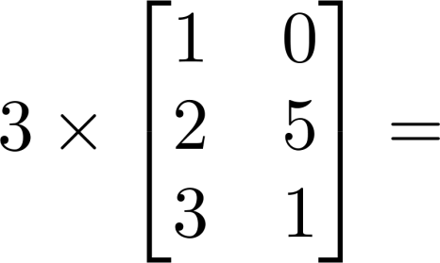
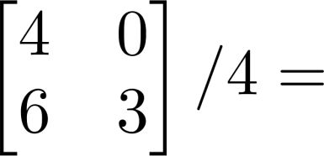
Scalar Multiplication

Slide 8
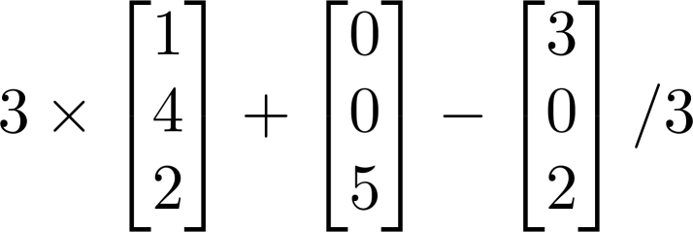
Combination of Operands

Slide 9
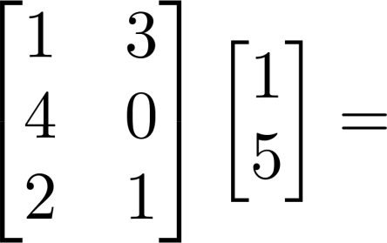
Example

Slide 10

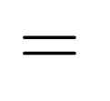



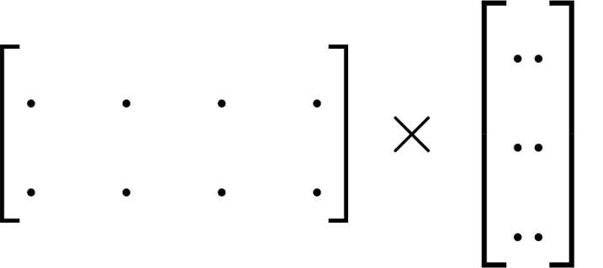
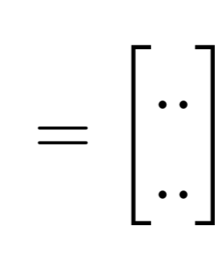

Details:
m x n matrix (m rows,
n columns)
n x 1 matrix (n-dimensional
vector)
m-dimensional
vector
To get
, multiply ’s
row with elements
of vector
, and add them up.

Slide 11
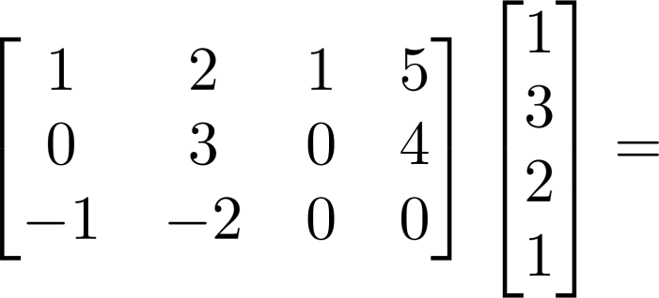
Example

Slide 12
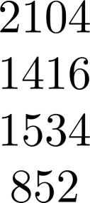

House sizes:

Slide 13
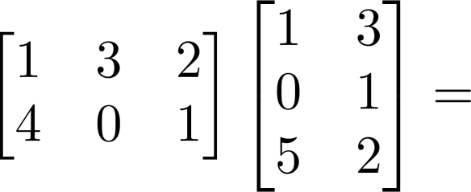
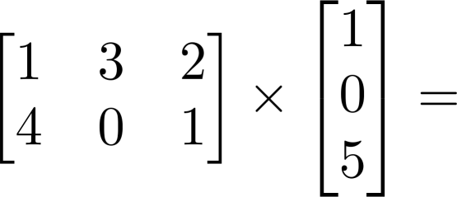
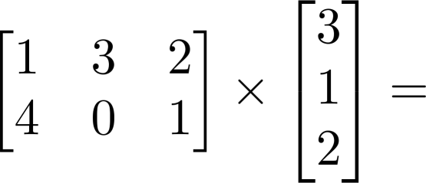
Example

Slide 14




Details:
m x n matrix (m rows,
n columns)
n x o matrix (n rows,
o columns)
m x o matrix
The column of the matrix
is obtained by multiplying
with the column of . (for
= 1,2,…,o)

Slide 15
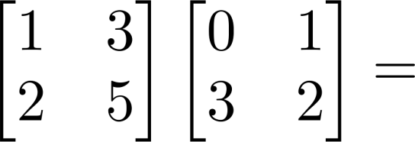
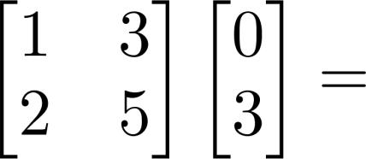
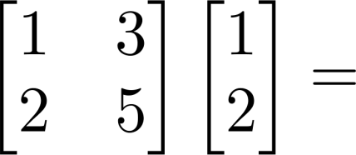
Example

Slide 16
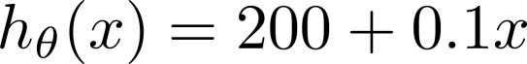
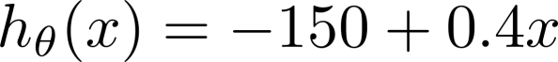
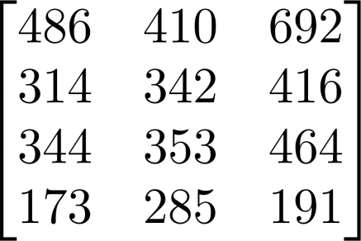
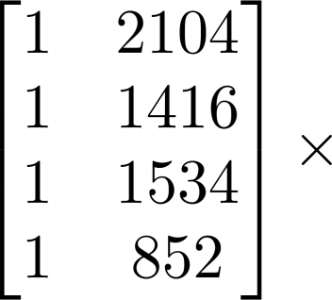
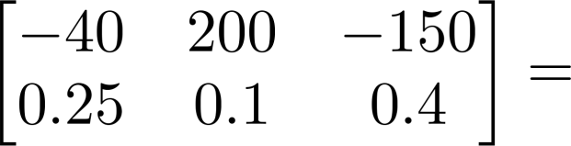
Have 3 competing hypotheses:
1.
2.
3.
House sizes:
Matrix
Matrix

Slide 17

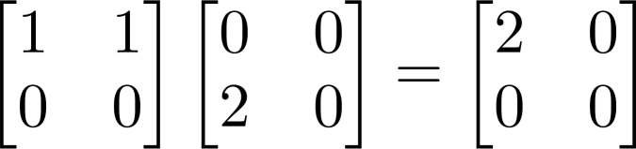
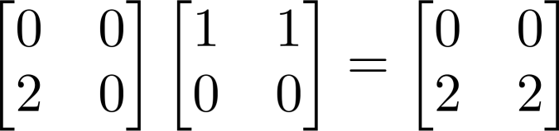
Let and be matrices. Then in general,
(not commutative.)
E.g.

Slide 18





Let
Let
Compute
Compute

Slide 19

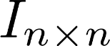
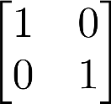
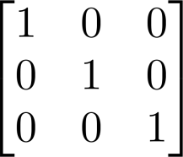
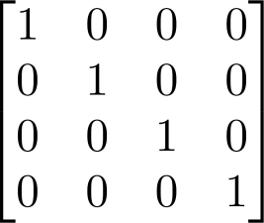
Identity Matrix
Denoted (or ).
Examples of identity matrices:
2 x 2
3 x 3
4 x 4
For any matrix ,

Slide 20
Not all numbers have an inverse.
Matrix inverse:
If A is an m x m matrix, and if it has an inverse,
Matrices that don’t have an inverse are “singular” or “degenerate”

Slide 21
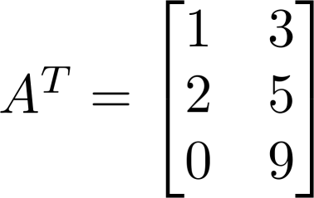
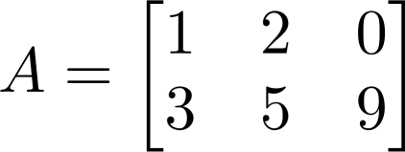

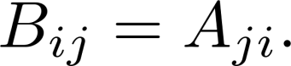
Matrix Transpose
Example:
Let be an m x n matrix, and let Then is an n x m matrix, and

Slide 22
Software Engineering - Collaboration
Notes:
What’s the reason we hold workshops and conferences?

Slide 23
Collaboration
We work together on projects, travel to workshops and conferences because we can pool our collective knowledge and experience to achieve more together than we can separately.

Slide 24
Collaboration
Collaboration:
Idea, process, and culture
Formal approach to sharing information, ideas, software, and results
Deceptively simple

Slide 25
Collaboration
Communication with your team
Tracking and monitoring the progress of your students
Collecting and reporting research results
Sharing tools and software you’ve developed
Tracking changes made to your software
Discussing problems and bugs encountered in software
Reporting bugs to developers
Responding to problems your users have reported
Notes:
All of us will face these questions every day, whether we’re conscious of it or not. Each of these questions is worthy of a lengthy discussion, but there’s a better approach…

Slide 26
Preparing For The Future
At a minimum:
Nightly software builds
Up to hourly software builds during “sprints”
Frequent patches
Increasingly complicated project management
More frequent delays and disruptions in communications

Slide 27
Dealing With Success
IT industry:
Created formal approach called “DevOps” we can adapt and implement to prepare for the future
Created tools to help individuals and teams collaborate more efficiently

Slide 28
DevOps
Both culture and process that emphasizes agility, flexibility, and responsiveness to users of our software
Continuous builds
Continuous integration
Continuous feedback
Notes:
We eat our own dogfood – we make our software for us, so we’re our own customers. More frequent releases need devops practices – we’ll get there someday soon.

Slide 29
DevOps
Code:
Develop and review software
Continuous integration
Build:
Status of builds
Version controls
Merging software
Test:
Results-oriented objective metrics
Package:
Artifact repositories
Pre-deployment staging
Notes:
Test: How do you define if your build succeeds? Can you tell where and when your build fails most often?

Slide 30
DevOps
Release:
Automate releases
Approve and manage changes
Configure:
“Infrastructure as Code”
Cloud computing
Automate configuration
Monitor:
Performance monitoring
Simulation, reconstruction, and analysis time to run
Notes:
Infrastructure as Code: virtualize everything Time to get first step of simulation working (with software install, etc) 2-3 months
Take one step forward, two steps backwards. Difficult to share problems I faced – how to reproduce, how to share logfiles, how to share changes etc Time to go from first step of simulation to complete automation: less than a week (emphasize this)

Slide 31
Collaborative Tools
DevOps relies on “toolchain”
Interconnected software that supports the DevOps process and culture
Tools support transparency, automation, and rapid dissemination of products
Notes:
Products: ideas, software we create, results of our research, ways we solved problems we encountered

Slide 32
Collaborative Tools
Many open-source or freeware tools exist
No guarantee they will integrate successfully
Slower releases, feature requests, and bugfixes
Fewer add-ons to achieve specific tasks
No single point of contact for support
Notes:
Not trying to sell any specific product – instead sell the ideas, process, and culture behind DevOps. Explain how these tools support this.

Slide 33
The Atlassian Tool Suite

Slide 34










What Atlassian does for teams
UNIQUE
COMMON
Tasks & projects
Pages & files
People
teams
comments
mentions
shares
notifications
Messages, & calls
Requests & SLAs
Code & reviews
Notes:
Main point: Our products have unique capabilities helping teams
Our products support a unique set of capabilities for teams. JIRA Software helps software teams better organize tasks and projects. Confluence is a place where teams can create and share content. HipChat focuses on real‑time messaging and communication.
JIRA Service Desk focuses on simplifying the requests and response and the workflow around requesting service from another part of the organization and then managing and fulfilling that service. Bitbucket is a place where developers can manage and discuss code.
Those are the unique collaborative capabilities of each of our product support teams. They unify a bunch of things for teams around people commenting, notifications, sharing, and @ mentioning, sort of the aspects of collaboration that really unite people around an object, whether it's a task, a page, or a message. That's what all of our products have in common.

Slide 35
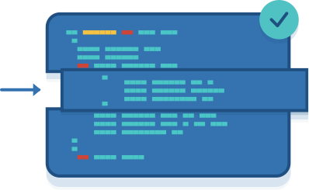



Atlassian for software teams
Everything your team needs to build & deliver great software, fast
Plan & track
Adopt agile best practices. Plan projects, manage dependencies and track team progress.
Build & ship
Collaborate on code with inline comments and pull requests. Manage and share your Git and Mercurial repositories.
Collaborate & document
Keep teams connected with chat. Collaborate on product requirements, roadmaps and technical documentation.
Automate & deploy
Embrace continuous delivery. Automate builds, tests and releases in a single workflow.
Notes:
Main point: Atlassian helps software teams plan, track, build & ship software faster and smarter
Our portfolio provides everything that a modern software team would need in order to design, build, and deliver great software fast.
From the very beginning we help teams with ideation and concepting. We help teams basically plan and track discreet work that's required for a software project. We help software developers share and collaborate around code and the actual building of the product so they can deliver it in time.
We help peripheral parts of the software team collaborate around documentation, around specification, around requirements. We also help automate the deployment of software, so we improve the quality and the continuous integration of software as it's being built and delivered out to customers.

Slide 36
What is a Programming Language?
A programming language is a notational system for describing computation in machine-readable and human-readable form.
Most of these forms are high-level languages, which is the subject of the course.
Assembly languages and other languages that are designed to more closely resemble the computer’s instruction set than anything that is human-readable are low-level languages.
Notes:
2
2

Slide 37
Why Study Programming Languages?
In 1969, Sammet listed 120 programming languages in common use – now there are many more!
Most programmers never use more than a few.
Some limit their career’s to just one or two.
The gain is in learning about their underlying design concepts and how this affects their implementation.
Notes:
3

Slide 38
The Six Primary Reasons
Increased ability to express ideas
Improved background for choosing appropriate languages
Increased ability to learn new languages
Better understanding of significance of implementation
Better use of languages that are already known
Overall advancement of computing
Notes:
4

Slide 39
Programming Domains
Scientific Applications
Business Applications
Artificial Intelligence
Web Software
Notes:
11

Slide 40
Artificial Intelligence
Artificial Intelligence deals with emulating human-style reasoning on a computer.
These applications usually involve symbolic computation, where most of the symbols are names and not numbers.
The most common data structure is the list, not the matrix or array as in scientific computing and not the record as in business computing
Artificial intelligence requires more flexibility than other programming domains.
Notes:
15

Slide 41
Artificial Intelligence Languages
The first AI language was IPL (International Processing Language, developed by the Rand Corporation. Its low-level design led to its limited use.
John McCarthy of MIT developed LIST for the IBM 704 (which eventually led to Scheme and Common LISP). LISP is a recursion-oriented, list-processing language that facilitated game-playing programs.
Yngve of MIT developed COMIT, a string-processing language, which was followed by AT&T’s SNOBOL.
Prolog was developed by Colmerauer, Roussel and Kowalski based on predicate calculus and mathematical logic.
Notes:
16

Slide 42
Systems Languages
Assembly languages were used for a very long time operating systems programming because of its power and efficiency.
CPL, BCPL, C and C++ were later developed for this purpose.
Other languages for systems programming included PL/I, BLISS, and extended ALGOL.
Notes:
17

Slide 43
Web Software
Eclectic collection of languages:
Markup (e.g., HTML) – used for annotating a document in a manner that can be distinguished from the text.
Scripting (e.g., PHP) - the language that enable the script to run these commands and typically include control structures such as if-then-else and while-do.
General-purpose (e.g., Java) – can be used for a wide range of programming jobs.
Notes:
18

Slide 44
Language Evaluation Criteria
Readability – the ease with which programs can be read and understood.
Writability – the ease with which programs can be developed for a given program domain.
Reliability – the extent to which a program will perform according to its specifications.
Notes:
19

Slide 45
An Example of Multiplicity
All of the following add one to the variable count in C:
count = count + 1;
count += 1;
count++;
++count;
Do they mean the same thing?
Notes:
24

Slide 46
Data Types and Structures
A more diverse set of data types and the ability of programmers to create their own increased program readability:
Booleans make programs more readable:
TimeOut = 1 vs. TimeOut = True
The use of records to store complex data objects makes programs more readable:
CHARACTER*30 NAME(100)
INTEGER AGE(100), EMPLOYEE_NUM(100)
REAL SALARY(100)
Wouldn’t it better if these were an array of records instead of 4 parallel arrays?
Notes:
28

Slide 47
Syntax
Most syntactic features in a programming language can enhance readability:
Identifier forms – older languages (like FORTRAN) restrict the length of identifiers, which become less meaningful
Special words – in addition to while, do and for, some languages use special words to close structures such as endif and endwhile.
Form and meaning – In C a static variable within a function and outside a function mean two different things – this is undesirable.
Notes:
29

Slide 48
Contributing Factors To Reliability
Type Checking – a large factor in program reliability. Compile-time type checking is more desireable. C’s lack of parameter type checking leads to many reliability problems.
Exception Handling – the ability to catch run-time errors and make corrections can prevent reliability problems.
Aliasing – having two or more ways of referencing the same data object can cause unnecessary errors.
Notes:
33

Slide 49
Cost of Use
Cost of program execution
A slower program is more expensive to run on a slower computer.
In an era of faster, cheaper computer, this is less of a concern.
Cost of program translation
Optimizing compilers are slower than some other compilers designed for student programs, which will not run as many times..
Cost of program creation, testing and use
How quickly can you get the program executing correctly.
Cost of program maintenance
How expensive will it be to modify the program when changes are needed in subsequent years?
Notes:
34

Slide 50
Influences on Language Design
Other factors have had a strong influence on programming language design:
Computer Architecture
Programming Methodologies
Notes:
35

Slide 51
Computer Architecture
Most computers are still based on the von Neumann architecture, which view memory as holding both instructions and data interchangably.
This has influenced the development of imperative languages and has stifled the adaption of functional languages.
As parallel processing computers are developed, there have been several attempts made to develop languages that exploit their features.
Notes:
36

Slide 52
Programming Methodologies
New methods of program development have led to advances in language design:
These have included:
structured programming languages
data abstraction in object-oriented languages
Notes:
37

Slide 53
Language Categories
There are four different programming language paradigms:
Imperative
Functional
Declarative
Object-Oriented
Notes:
38

Slide 54
Imperative Languages
Imperative languages are command-driven or statement-oriented languages.
The basic concept is the machine state (the set of all values for all memory locations).
A program consists if a sequence of statements and the execution of each statement changes the machine state.
Programs take the form:
statement1;
statement2;
… …
FORTRAN, COBOL, C, Pascal, PL/I are all imperative languages.
Notes:
39

Slide 55
Functional Languages
An functional programming language looks at the function that the program represents rather than the state changes as each statement is executed.
The key question is: What function must be applied to our initial machine and our data to produce the final result?
Statements take the form:
function_{n}(function₁, function₂, … (data)) … )
ML, Scheme and LISP are examples of functional languages.
Notes:
40

Slide 56
A Function GCD in C++
//gcd() - A version of greatest common
// divisor written in C++ in
// function style
int gcd(int u, int v)
{
if (v == 0)
return(u);
else
return(v, u % v);
}
Notes:
42

Slide 57
Rule-Based Languages
Rule-based or declarative languages execute checking to see if a particular condition is true and if so, perform the appropriate actions.
The enabling conditions are usually written in terms of predicate calculus and take the form:
condition₁ → action₁
condition₂ → action₂
… … …
Prolog is the best know example of a declarative language.
Notes:
43

Slide 58
Object-Oriented Languages
In object-oriented languages, data structures and algorithms support the abstraction of data and endeavor to allow the programmer to use data in a fashion that closely represents its real world use.
Data abstraction is implemented by use of
Encapsulation – data and procedures belonging to a class can only be accessed by that classes (with noteworthy exceptions).
Polymorphism – the same functions and operators can mean different things depending on the parameters or operands,
Inheritance – New classes may be defined in terms of other, simpler classes.
Notes:
45

Slide 59
GCD in Java
public class IntWithGcd
{ public IntWithGcd( int val ){ value = val; }
public int intValue() { return value; }
public int gcd( int val );
{ int z= value;
int y = v;
while (y != 0)
{
int t = y;
y = z % y;
z = t;
}
return z;
}
private int value;
}
Notes:
46

Slide 60
Implementation Methods
Compilation
Pure Interpretation
Hybrid Implementation Systems
Notes:
48

Slide 61
The Compiling Process
Source
Code
Executable
version
Compiler
Object
Module
Linker
Assembler version
Notes:
49

Slide 62
The Pure Interpretation Process
Source
Code
Interpreter
Output
Input
Notes:
50

Slide 63
The Hybrid Interpretation Process
Source
Code
Interpreter
Intermediate
Version
Interpreter
Output
Input
Notes:
51

Slide 64
Data Science Architecture

Slide 65









Data Mining
Analytics
use
Data Warehouse
are comprised of
uses
uses data stored in
is closely related to
automate
interfaces with/ provides
analyze
Machine Learning
Data Analytics
Business Intelligence
OLAP
uses
uses
is a type
is a type of
reports
feeds data into
of
Quantitative Analysis
Quantitative Analysis
KPIs
ETL
uses
OLTP
is used for
is used for
Commodity Hardware
Data Science Model
- Shows the “Big Picture”
- Dependencies
generally uses
Big Data Solution
can process
is an open-source implementation of
provides storage for
Large Datasets
Hadoop
NoSQL Databases
Source: www.arcitura.com
Benjamin Harvey, Ph.D., EMSE 6992 – Introduction to Data Analytics

Slide 66








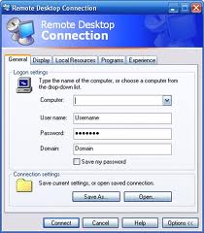

Cloud Infrastructures
Data Cloud (Comp.)
Storage Cloud
MapReduce
File System
Utility Cloud

Slide 67












DATA
CLOUD
STORAGE
CLOUD
Amazon Elastic Elastic MapReduce (EMR)
Amazon Simple Storage Service (S3)
UTILITY
CLOUD
Amazon Elastic Compute Cloud (EC2)
Benjamin Harvey, Ph.D., EMSE 6992 – Introduction to Data Analytics

Slide 68
DATA
CLOUD
STORAGE
CLOUD
Amazon Elastic Elastic MapReduce (EMR)
Amazon Simple Storage Service (S3)
Utility
CLOUD
UTILITY
CLOUD
Data Cloud History
Amazon Elastic Compute Cloud (EC2)
Amazon Elastic Compute Cloud (EC2)
MapReduce
File System
Benjamin Harvey, Ph.D., EMSE 6992 – Introduction to Data Analytics

Slide 69
REFERENCE SLIDES

Slide 70
Housing Prices
(Portland, OR)
Price
(in 1000s of dollars)
Size (feet²)
Supervised Learning
Given the “right answer” for each example in the data.
Regression Problem
Predict real-valued output

Slide 71
Training set of
housing prices
(Portland, OR)
Size in feet² (x) | Price ($) in 1000's (y)
2104 | 460
1416 | 232
1534 | 315
852 | 178
… | …
Notation:
m = Number of training examples
x’s = “input” variable / features
y’s = “output” variable / “target” variable

Slide 72
Training Set
How do we represent h ?
Learning Algorithm
Size of house
h
Estimated price
Linear regression with one variable.
Univariate linear regression.

Slide 73


Training Set
Size in feet² (x) | Price ($) in 1000's (y)
2104 | 460
1416 | 232
1534 | 315
852 | 178
… | …
Hypothesis:
‘s: Parameters
How to choose ‘s ?

Slide 74
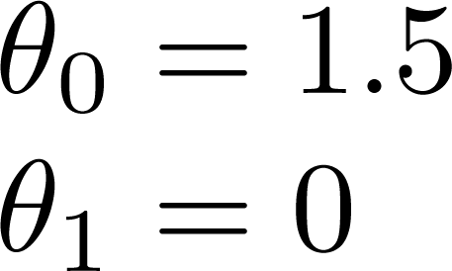
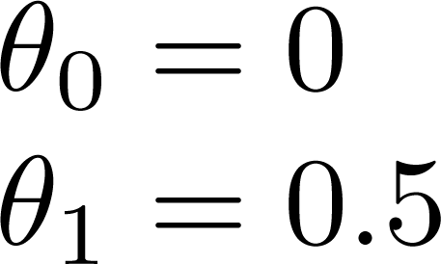
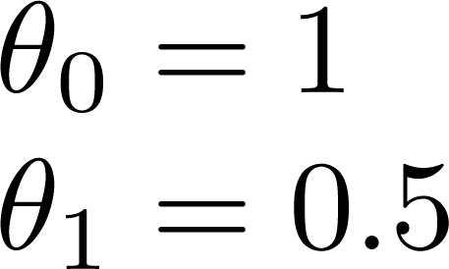

Slide 75



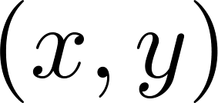
y
x
Idea: Choose so that is close to for our training examples

Slide 76
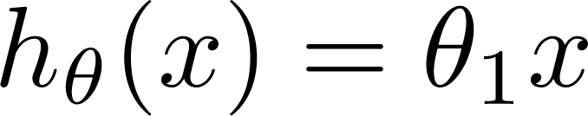

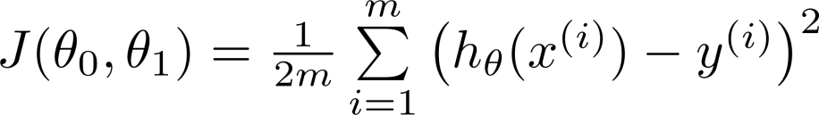
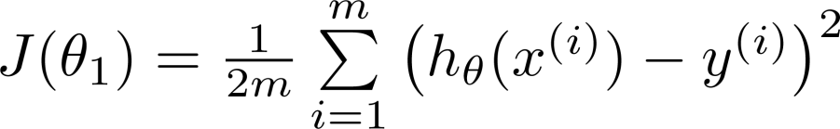
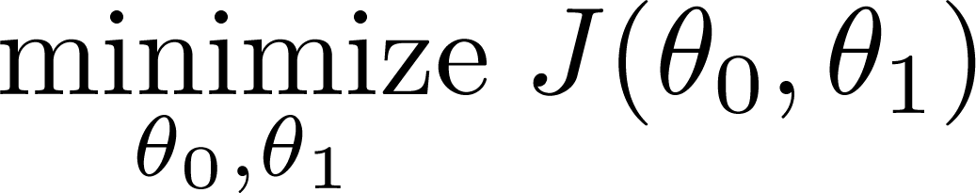
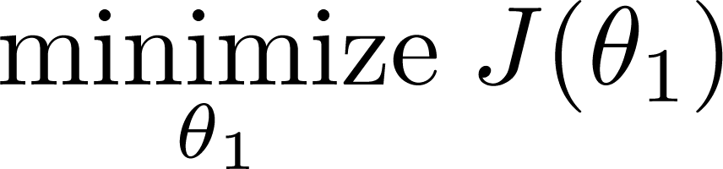
Simplified
Hypothesis:
Parameters:
Cost Function:
Goal:

Slide 77
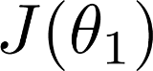



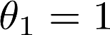
(for fixed , this is a function of x)
(function of the parameter )
y
x

Slide 78

(for fixed , this is a function of x)
(function of the parameter )
y
x

Slide 79

(for fixed , this is a function of x)
(function of the parameter )
y
x

Slide 80

Hypothesis:
Parameters:
Cost Function:
Goal:

Slide 81




(for fixed , this is a function of x)
(function of the parameters )
Price ($)
in 1000’s
Size in feet² (x)

Slide 82


Slide 83


(for fixed , this is a function of x)
(function of the parameters )

Slide 84


(for fixed , this is a function of x)
(function of the parameters )

Slide 85


(for fixed , this is a function of x)
(function of the parameters )

Slide 86


(for fixed , this is a function of x)
(function of the parameters )

Slide 87

Have some function
Want
Outline:
Start with some
Keep changing to reduce until we hopefully end up at a minimum

Slide 88

J(θ₀,θ₁)
θ₁
θ₀

Slide 89
J(θ₀,θ₁)
θ₁
θ₀

Slide 90




Gradient descent algorithm
Correct: Simultaneous update
Incorrect:

Slide 91


Gradient descent algorithm

Slide 93

If α is too small, gradient descent can be slow.
If α is too large, gradient descent can overshoot the minimum. It may fail to converge, or even diverge.

Slide 94


at local optima
Current value of

Slide 95
Gradient descent can converge to a local minimum, even with the learning rate α fixed.
As we approach a local minimum, gradient descent will automatically take smaller steps. So, no need to decrease α over time.

Slide 96


Gradient descent algorithm
Linear Regression Model

Slide 97




Slide 98


Gradient descent algorithm
update
and
simultaneously

Slide 99
J(θ₀,θ₁)
θ₁
θ₀

Slide 100
J(θ₀,θ₁)
θ₁
θ₀

Slide 102


(for fixed , this is a function of x)
(function of the parameters )

Slide 103

(for fixed , this is a function of x)
(function of the parameters )

Slide 104


(for fixed , this is a function of x)
(function of the parameters )

Slide 105


(for fixed , this is a function of x)
(function of the parameters )

Slide 106

(for fixed , this is a function of x)
(function of the parameters )

Slide 107

(for fixed , this is a function of x)
(function of the parameters )

Slide 108


(for fixed , this is a function of x)
(function of the parameters )

Slide 109

(for fixed , this is a function of x)
(function of the parameters )

Slide 110


(for fixed , this is a function of x)
(function of the parameters )

Slide 111
“Batch” Gradient Descent
“Batch”: Each step of gradient descent uses all the training examples.

